Slide 1

Methodological Solutions
Machine Learning approaches to identify climate change impacts
Michael Rogo Opata
Interdisciplinary Institute of Scientific Computing

Slide 2
Outline
Basic Introduction to ML terms (What exactly is going on under the hood)
Climate change patterns
Methodological approach 1
Methodological approach 2
Discussion/Q&A

Slide 3
Basic Introduction
We will discuss Supervised ML and NNs
I am assuming that you already have a deep understanding of ML

Slide 4
What exactly is our aim?
Features | Labels
X_train | y_train
X_test | y_test
70% or 80%
Probabilities
30% or 20%

Slide 5
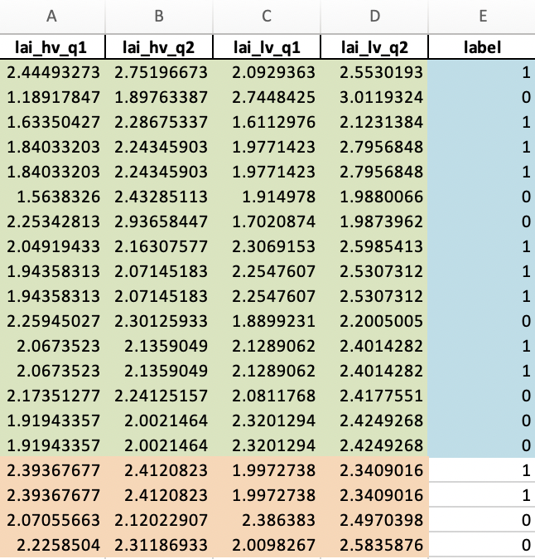
Let’s have a look at a sample data
features
X_train
y_train
X_test
y_test (Probabilities)

Slide 6
Methods to identify impact of CC
A few points to note
ML is a black box method
It will not give you a straight no or yes!
Instead we are dealing with probabilities

Slide 7
What method do I use?
It depends on the question at hand
And the data that you are looking at
Text data or
Images

Slide 8
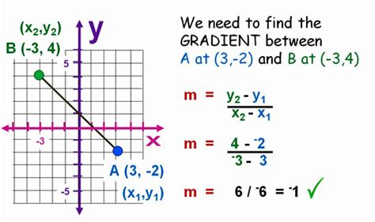
Gradient Boosted trees as a method
“gradient boosting” comes from the idea of “boosting” or improving a single weak model
by combining it with a number of other weak models in order to generate a collectively strong model
Formalised as a gradient descent algorithm over an objective function

Slide 9
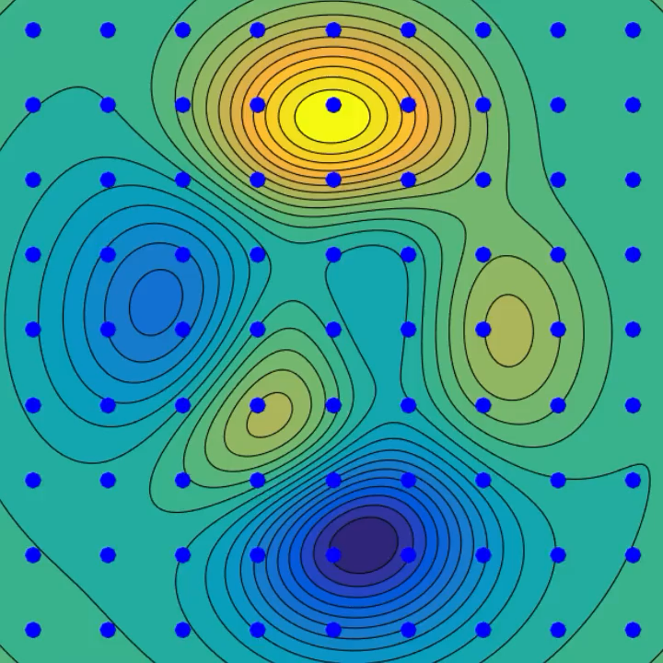
A visual rep of what we are talking about

Slide 10
How GBM works
Instance | Age | Has job | Owns house | Income ($1000)
0 | 12 | N | N | 0
1 | 32 | Y | Y | 90
2 | 25 | Y | Y | 50
3 | 48 | N | N | 25
4 | 67 | N | Y | 35
5 | 18 | Y | N | 10
Income as target

Slide 11
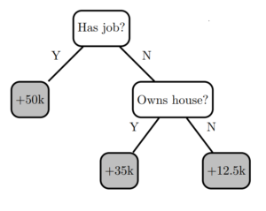
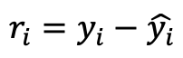
Ideally we construct decision trees
Instance | Age | Has job | Owns house | Income ($1000) | Residuals
0 | 12 | N | N | 0 | -12.5
1 | 32 | Y | Y | 90 | 40
2 | 25 | Y | Y | 50 | 0
3 | 48 | N | N | 25 | 12.5
4 | 67 | N | Y | 35 | 0
5 | 18 | Y | N | 10 | -40
Tree 0
Get residuals to know whether we have underestimated or
overestimated
The performance is good on some labels but not good on others
$$r_{i}=y_{i}−\hat{y_{i}}$$

Slide 12
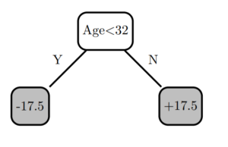
Let’s construct decision trees 1
Build another decision tree, but this time try to predict the residuals instead of the original labels.
Instance | Age | Has job | Owns house | Income ($1000) | Tree 0 Residuals | Tree 1 Residuals
0 | 12 | N | N | 0 | -12.5 | 5
1 | 32 | Y | Y | 90 | 40 | 22.5
2 | 25 | Y | Y | 50 | 0 | 17.5
3 | 48 | N | N | 25 | 12.5 | -5
4 | 67 | N | Y | 35 | 0 | -17.5
5 | 18 | Y | N | 10 | -40 | -22.5

Slide 13
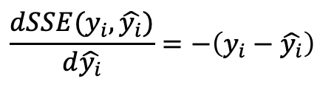
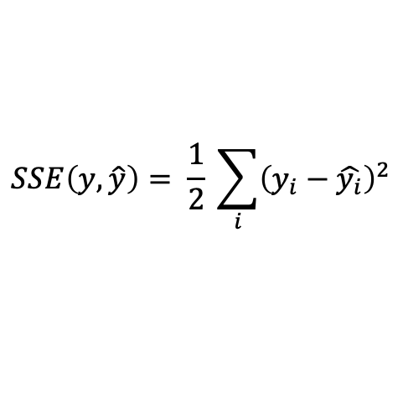
Sum of Squared Errors (SSE)
Looking at the sum of squared errors for the extended model. (SSE)
Taking the gradient of the SSE loss function for a single training instance explains why the model increases in performance
$$SSE\left(y,\hat{y}\right)= \frac{1}{2} \sum_{i}{{\left(y_{i}−\hat{y_{i}}\right)}^{2}}$$
$$\frac{dSSE(y_{i},\hat{y_{i}})}{d\hat{y_{i}}}=−\left(y_{i}−\hat{y_{i}}\right)$$
Model | SSE
No model (predict 0) | 6275
Tree 0 | 1756
Tree 0 + Tree 1 | 837

Slide 14
Applying the knowledge to climate changes
First we begin with a research question
In most cases we start from an intuition
The talk will be largely pedagogical

Slide 15
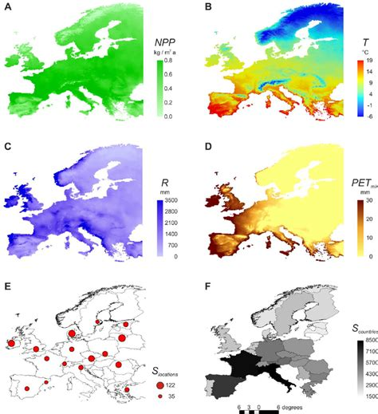
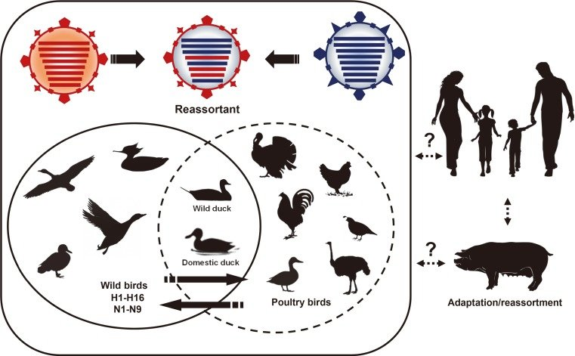
Research question
Climate
Living organisms

Slide 16
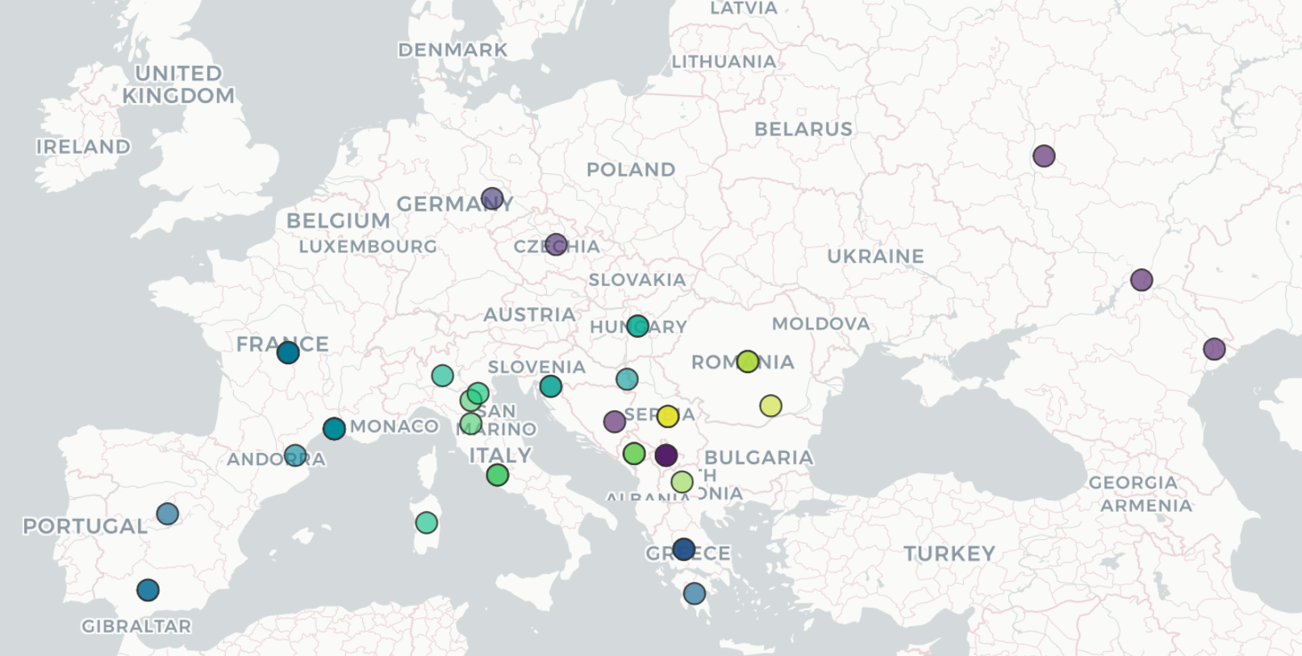
Research question

Slide 17
Research question
What are the eco-climate drivers of West Nile Virus (WNV)?
Here we have an intuition that temperature or any other climate variable plays a critical role in the dynamics of the disease
The question we are answering using ML is;
what climatic variables will impact on WNV cases/outbreak events as a disease or any other disease?

Slide 18
Data set up
1.) Select the features
2.) Label the cases
F1 | F2 | F3 | F4 | F5 | F6 | F7 | Label
What’s more Important is how we engineer the features

Slide 19
Data sources and variables
We need to decide what variables to include
Here we include:
Feature | Source
Temperature | cds
Rainfall | cds
Vegetation Index | cds
Water Index | MODIS
Vegetation Index | Terra 1
Socio-economic | Eurostats
Mosquito data | Cdc
Bioclimatic data | Bioclima.org

Slide 20
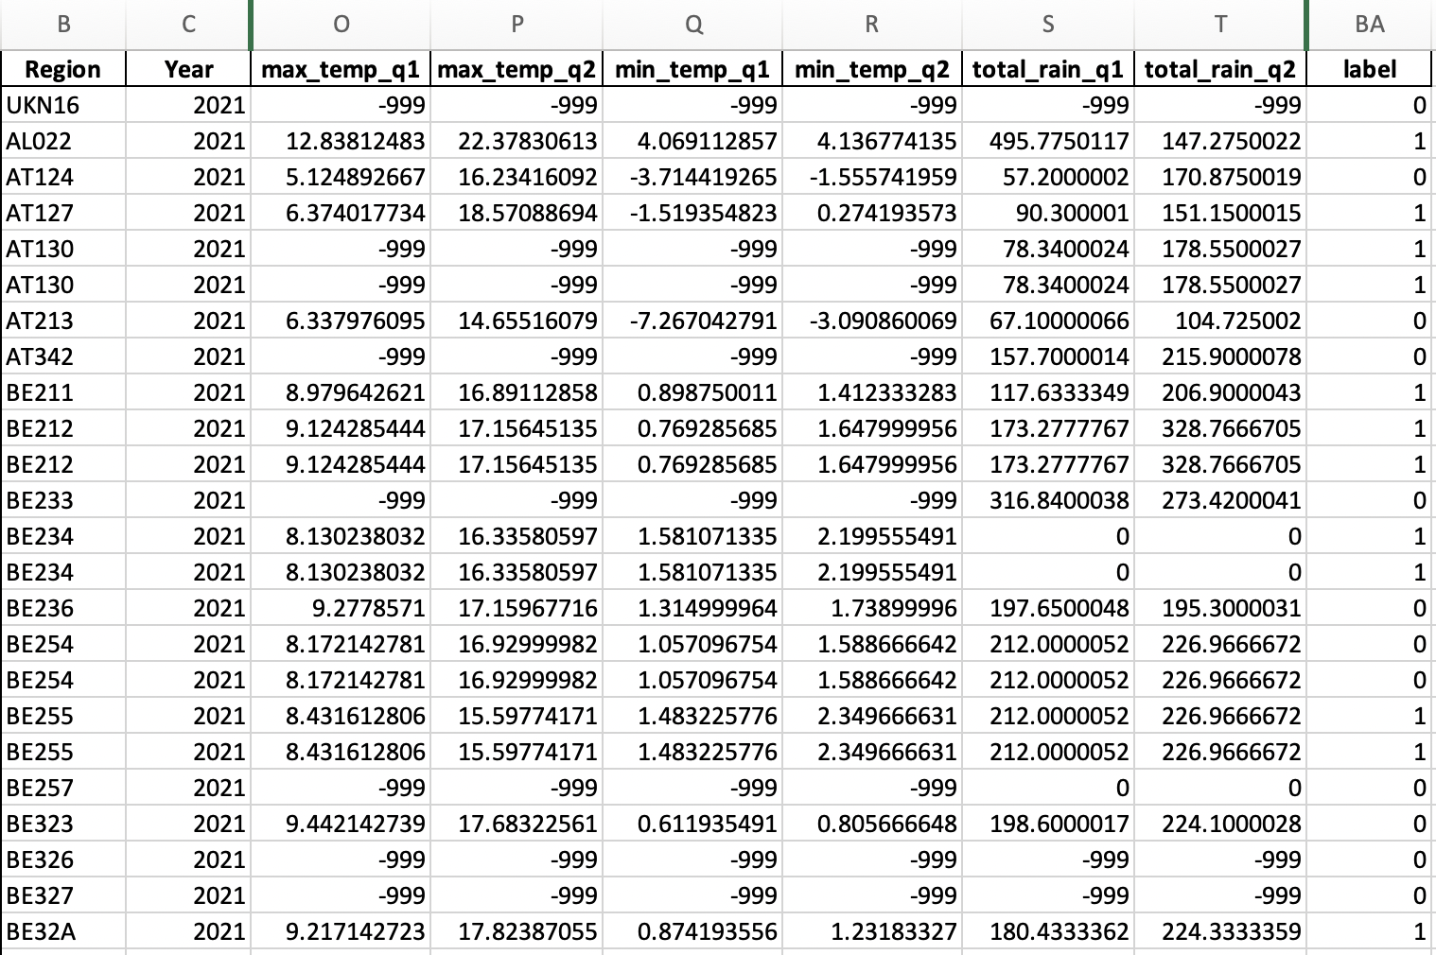
Organizing the data

Slide 21

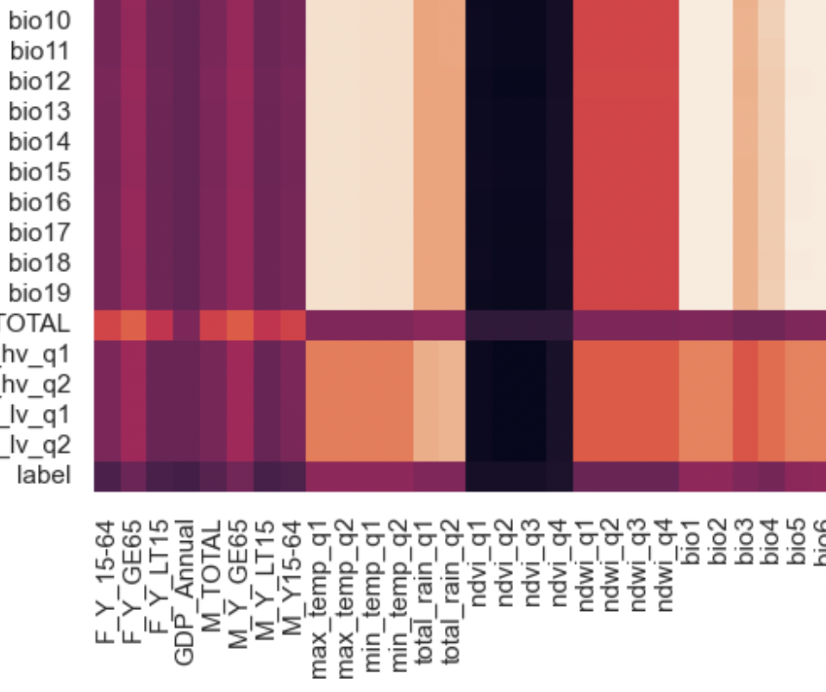
Correlation between features
-- Low correlation is a good sign
-- High correlated features is not such a great sign

Slide 22
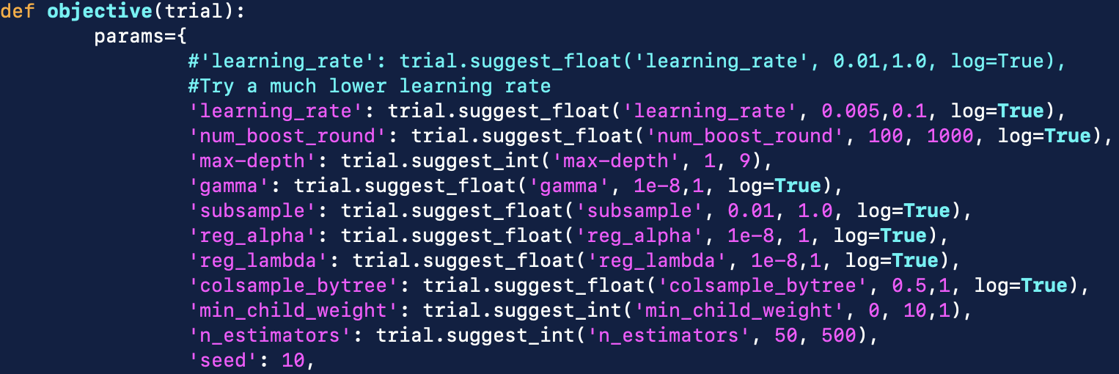
Tuning, cross-validation and evaluation

Slide 23
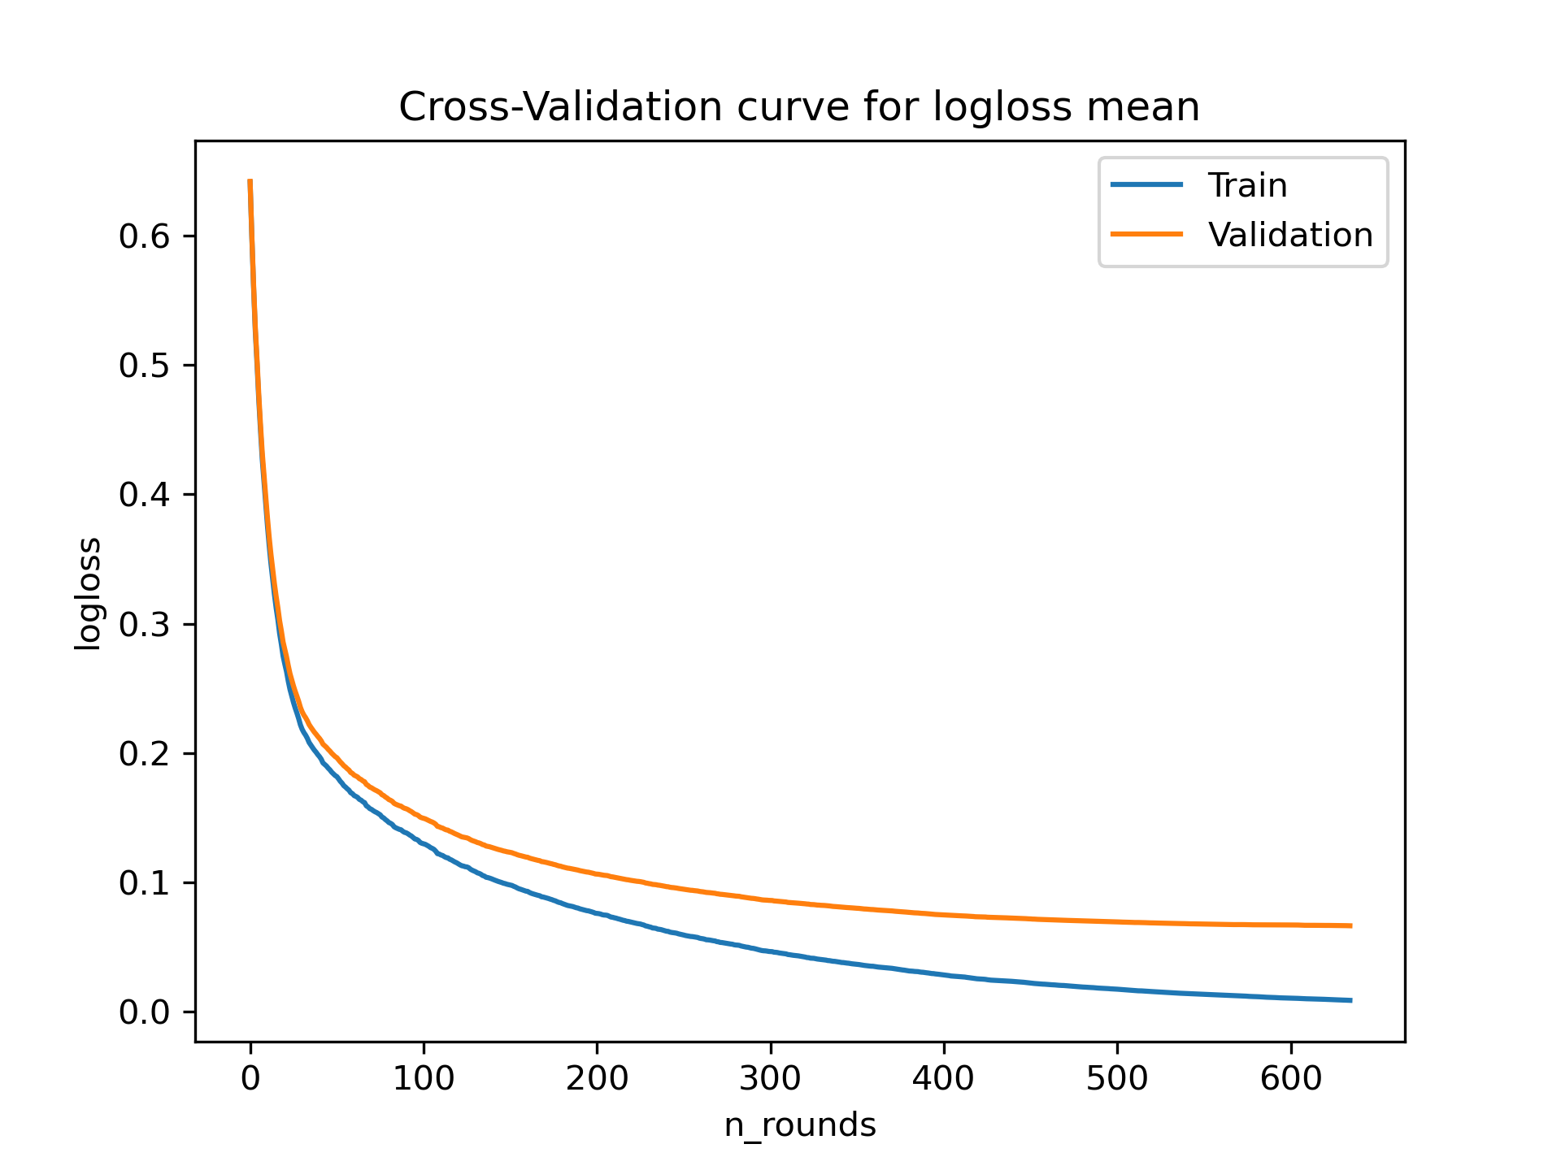
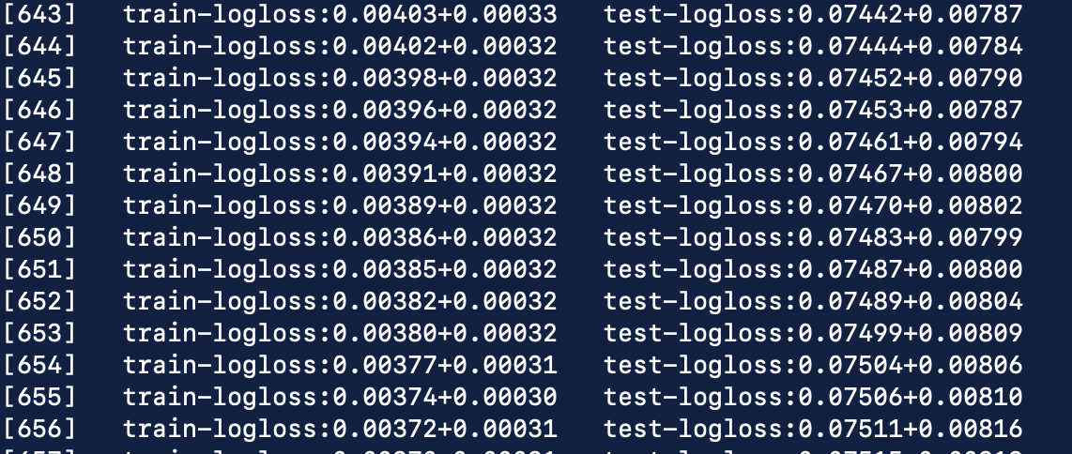
Cross-validation plot

Slide 24
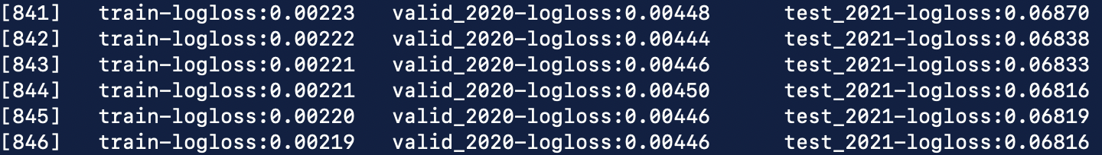
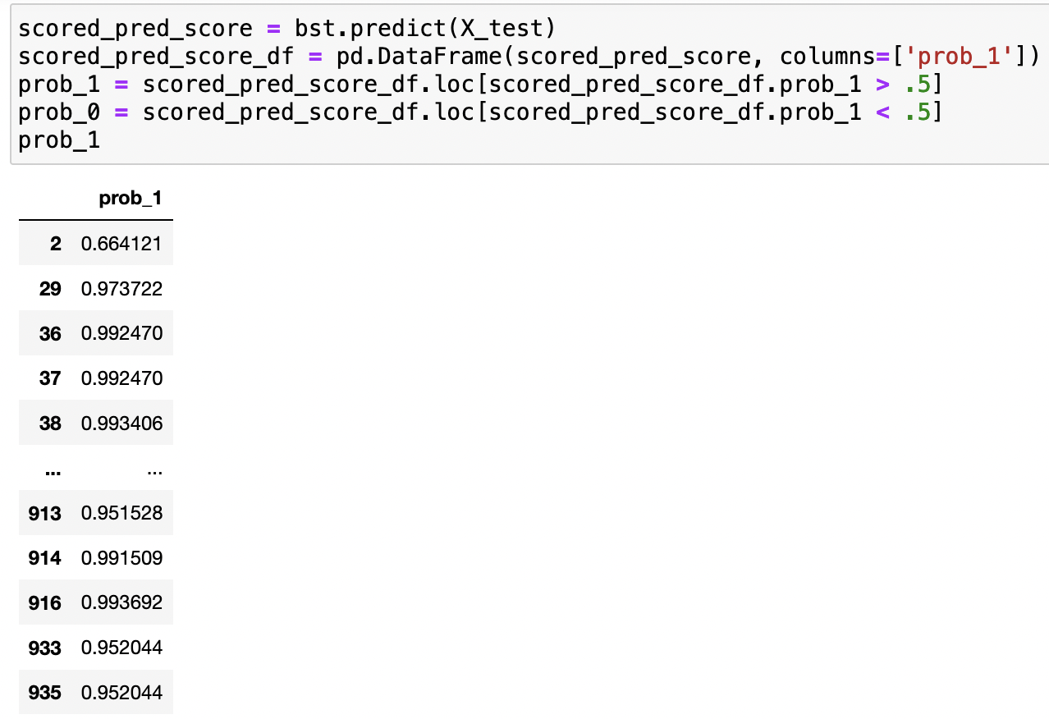
Check the probabilities

Slide 25
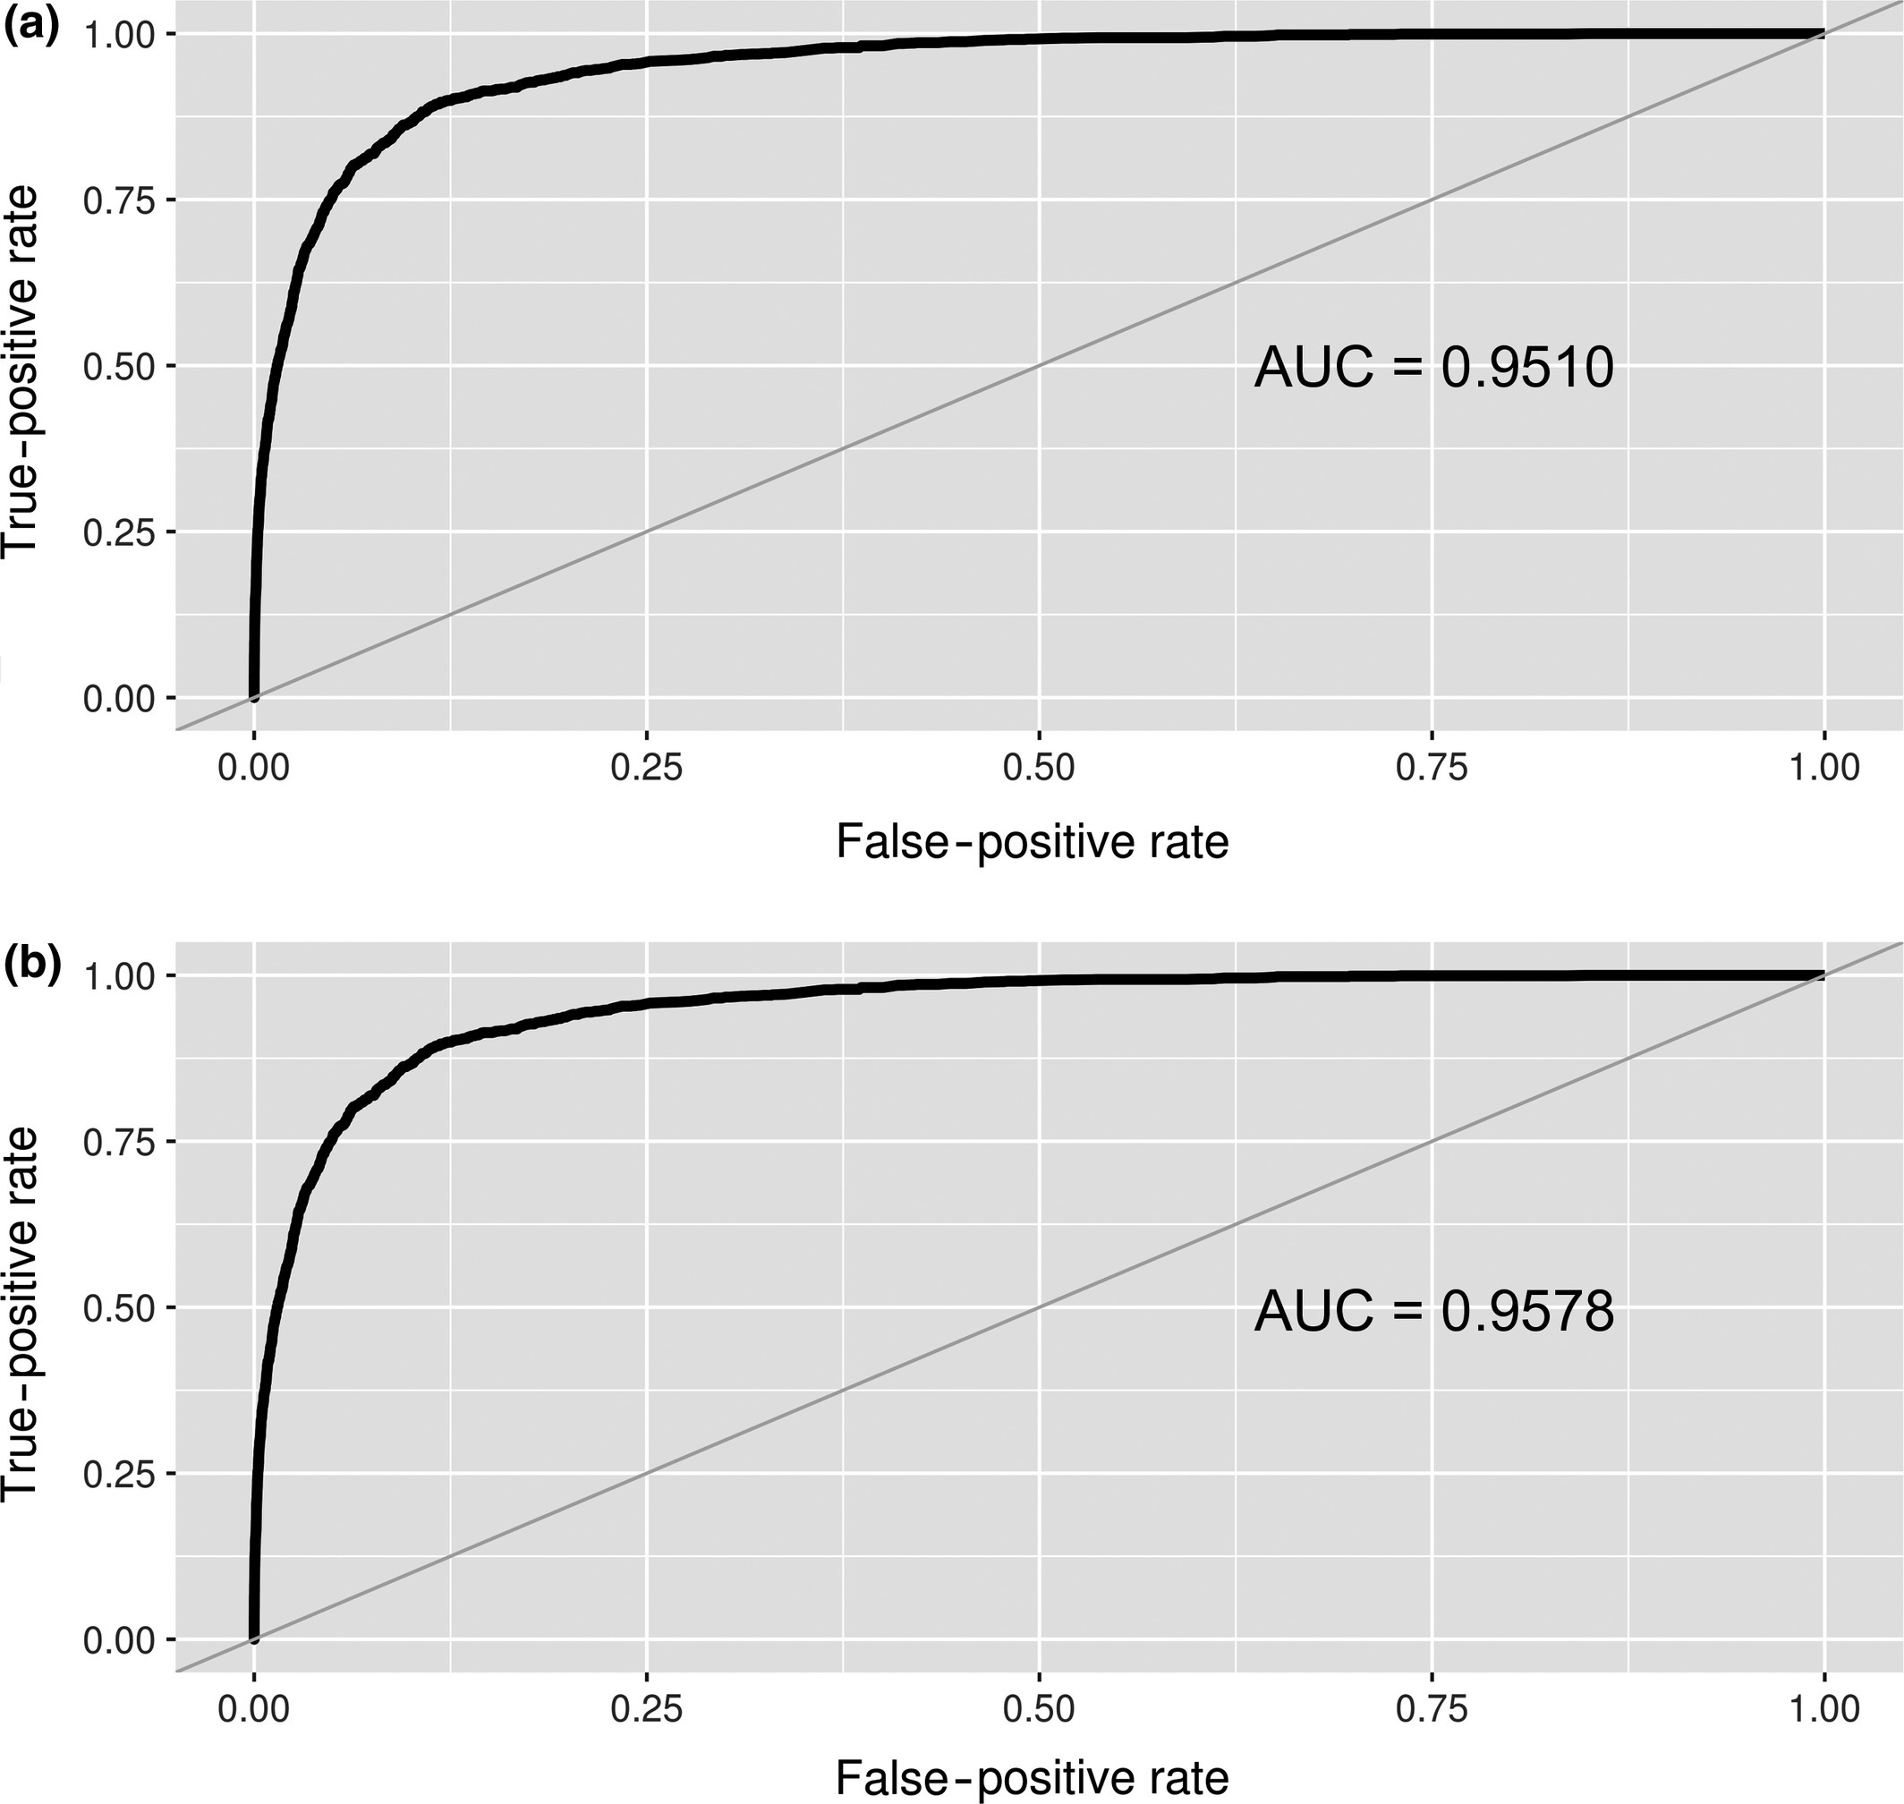
Evaluation metrics
There are several ways to evaluate a model
Area Under Curve
Logloss
Absolute squared error
Root mean square error
Root mean square log error
Multiclass classification error rate

Slide 26
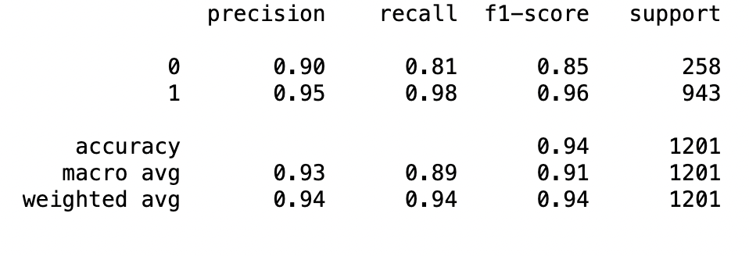
Is your model selective enough?
Precision → When a positive value is negative, how often is the prediction correct
Recall → Similar to specificity, when the actual value is negative, how often is the prediction correct?
F1-score → Harmonic mean of the precision and recall

Slide 27
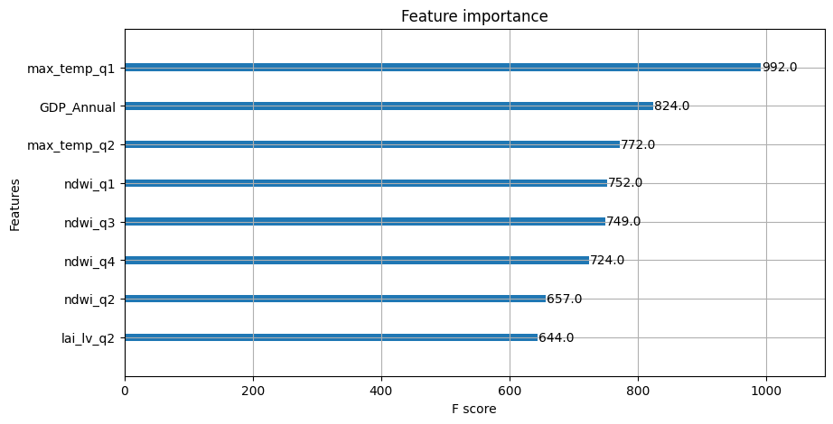
Interpreting the model
One can use XGBoost internal tools
Sample feature importance plot of variables from the model

Slide 28
Using SHAP or LIME for explainability
- SHapely Additive exPlanations (SHAP)
- Local Interpretable Model-Agonistic Explanations (LIME)
Additive feature attribution methods to break down individual contribution of each feature
simplify the global complexity in the model and approximate it around the vicinity of particular instances

Slide 29
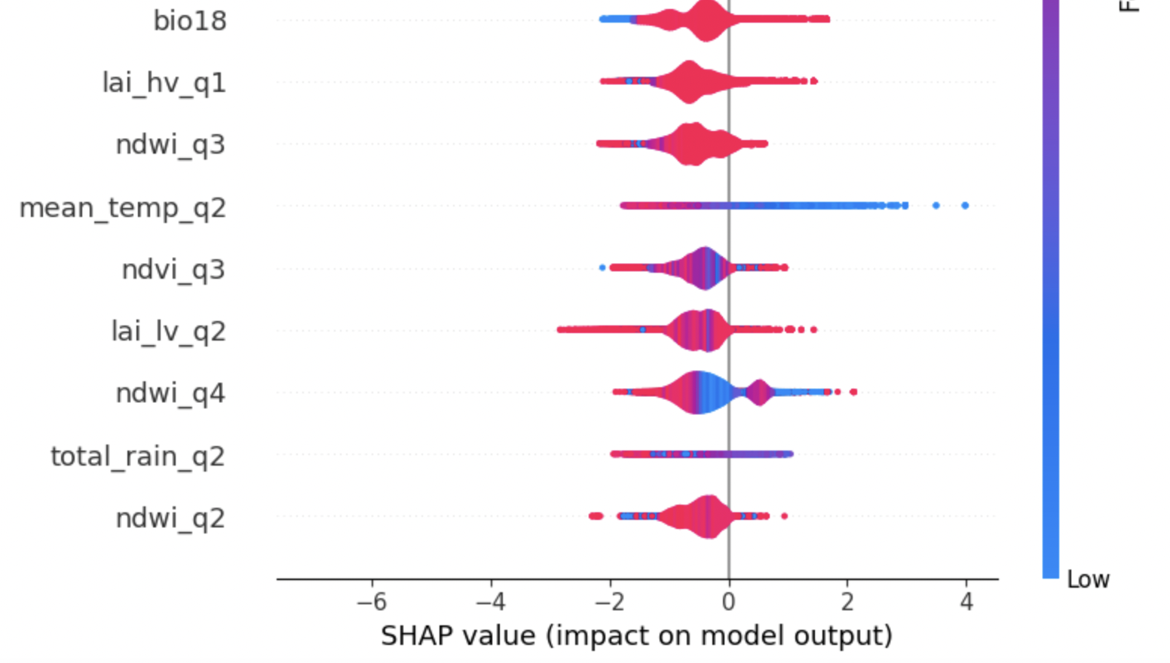
Sample SHAP output

Slide 30
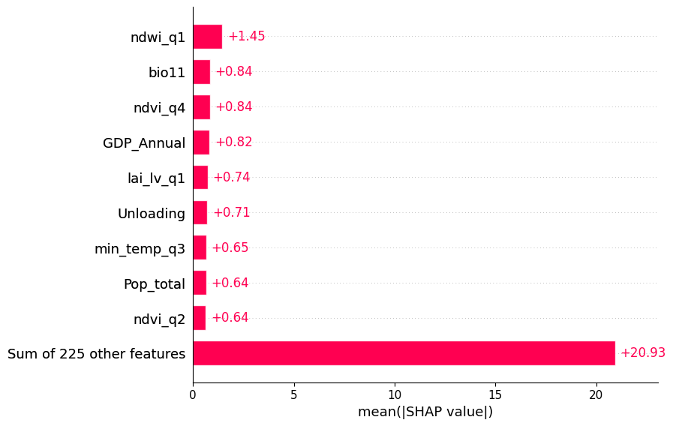
SHAP mean values

Slide 31
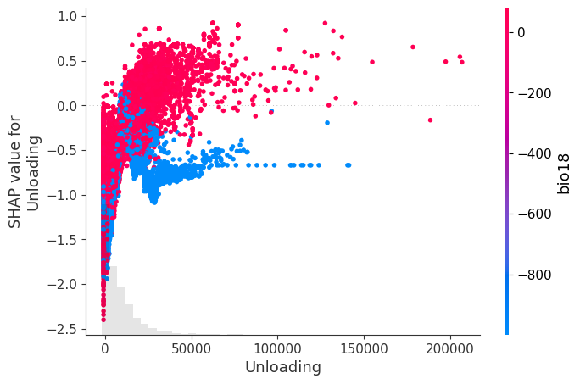
Dissecting the features further

Slide 32
Going back to our climate impact model
We can conclude that NDWI Plays an important role in the model
Followed by bio11
We can also explain why other factors are not important

Slide 33
Any burning questions so far?

Slide 34
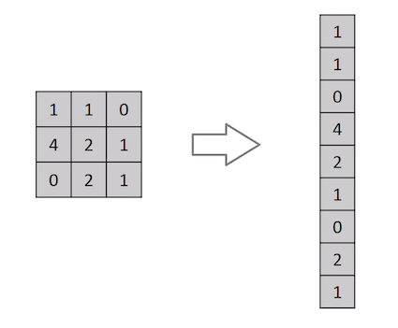
Tropical Cyclone Intensity Estimation using a Deep Convolutional Neural Network
So why not just flatten the image (e.g. 3x3 image matrix into a 9x1 vector) and feed it to a Multi-Level Perceptron for classification purposes?

Slide 35

Convolutional Neural Network

Slide 36
How CNNs Work
Used for extracting high-level features from the images such as edges/other patterns
certain filters do operations such as blurring the image,
sharpening the image and then
performing pooling operations on each of these filters to extract information from an image
First layer captures Low-Level features such as edges, color, gradient orientation

Slide 37

The Kernel
Hadamard Products

Slide 38


Pooling layer

Slide 39
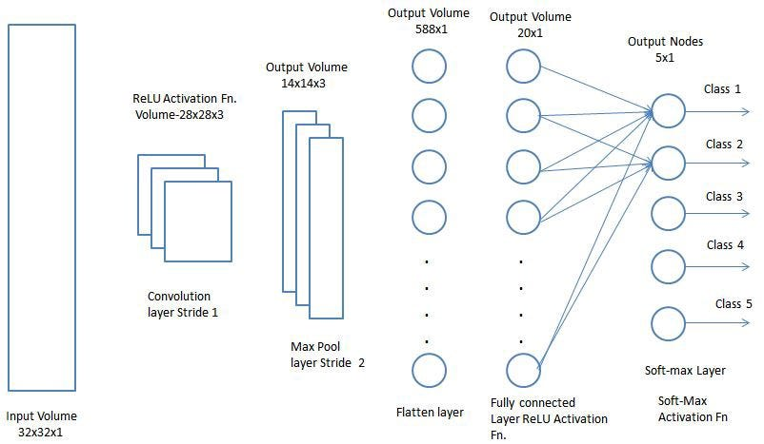
Classification — Fully Connected Layer (FC Layer)

Slide 40
Approaching the Problem
Data: we need data which is pre-processed and can be fed into the network.
Task: understand and define the problem statement accurately.
Model: We need to build our model
Loss: carefully choose a loss function which is suitable for the task
Learning: choose an optimiser which is suitable for our task and train our model using the set hyperparameters.
Evaluation: crucial step in the process to determine if our model has learnt the features properly by analysing how it performs when unseen data is given to it.

Slide 41
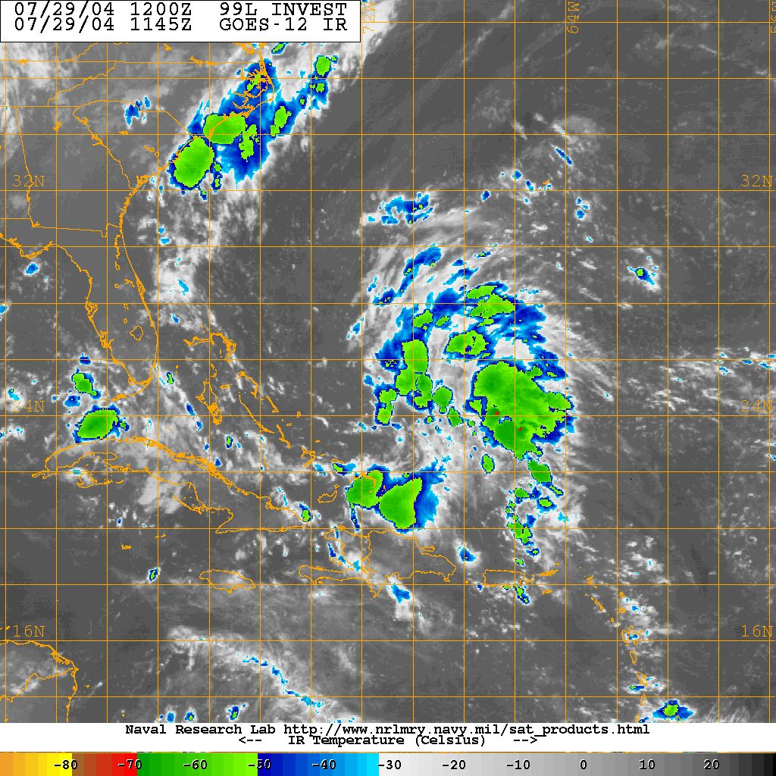
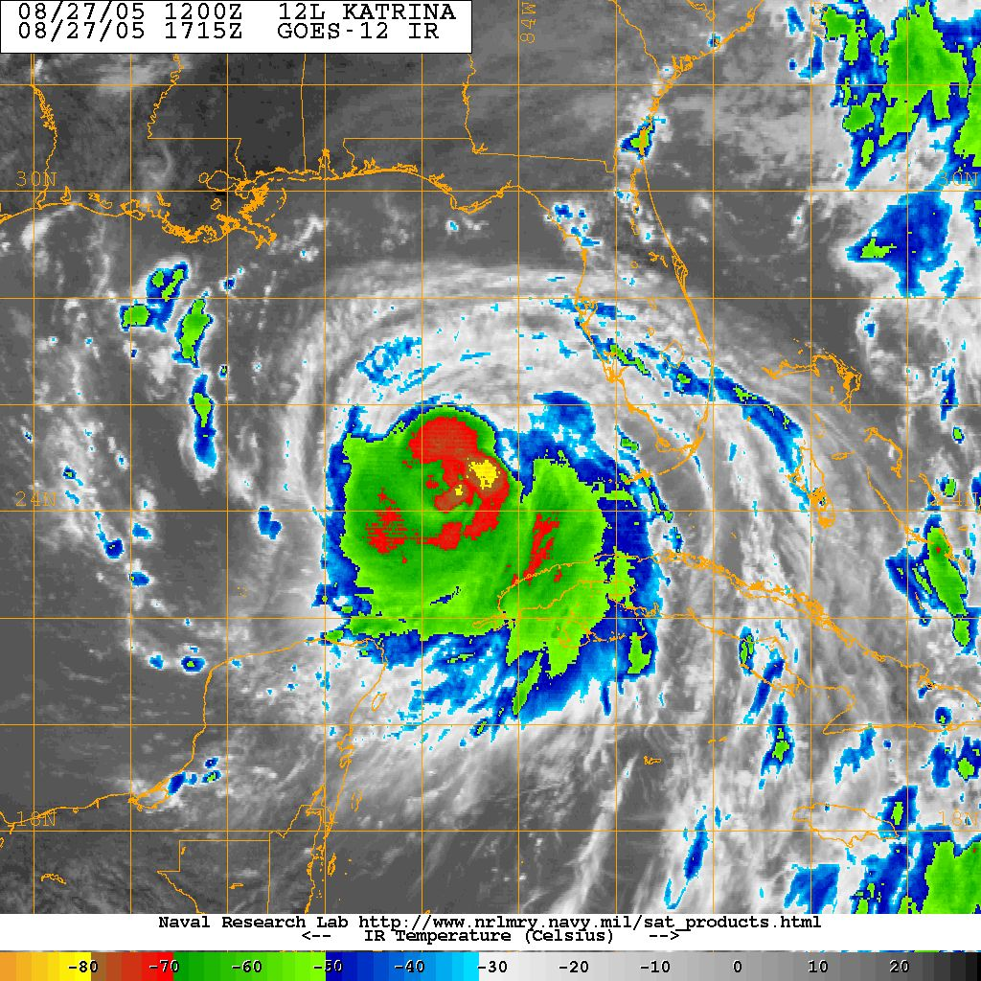
Data

Slide 42
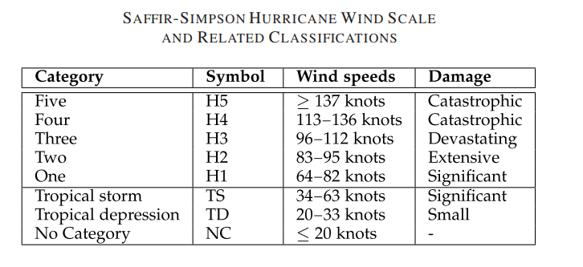
Categorize the data

Slide 43
Task
This task is called Multi-class Classification.
Here, multiple classes are present, and the model needs to classify the image into the correct class.
The Classes here are the intensity of the tropical cyclone which will be estimated using the wind speeds of the cyclone:
NC ( No Category , knots)
TD ( Tropical Depression , knots)
TS ( Topical Storm , knots)
H1 ( Category One , knots)
H2 ( Category Two , knots)
H3 ( Category Three , knots)
H4 ( Category Four , knots)
H5 ( Category Five , knots)

Slide 44
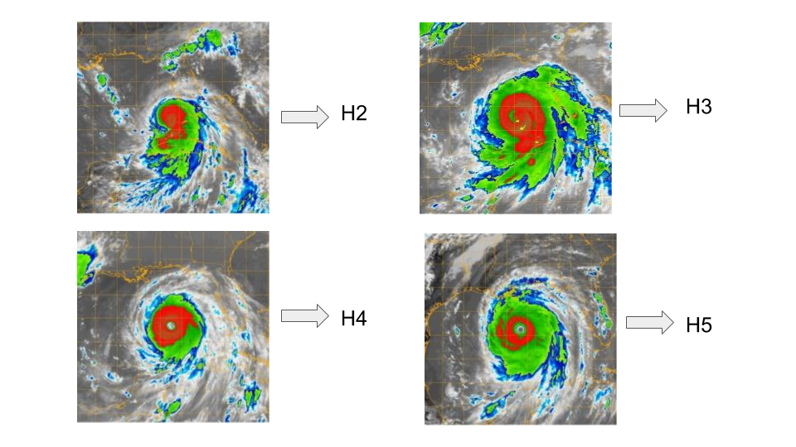
Example task

Slide 45
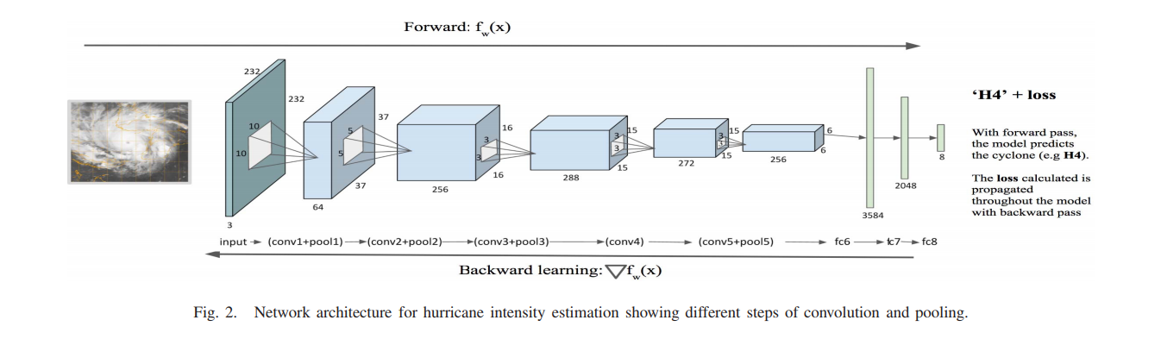
Model and Loss

Slide 46
Loss Function
Multi-Class Cross-Entropy Loss
Sparse Multi-class Cross-Entropy Loss
Kullback Leibler Divergence Loss

Slide 47
Multi-Class Cross-Entropy loss
When we train our model , we convert all the categories to a array of 1's and 0’s
cat = [ 1 , 0 ] and dog = [ 0 , 1 ]
our model will then predict the probabilities of the output of what it thinks it to be
Image of a cat is predicted to be [ 0.87 , 0.13]
The model is 87% confident that it is a cat

Slide 48
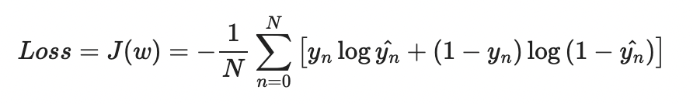
Let’s calculate the error
still not good enough we then calculate the error
[ 0.87 , 0.13]
If our model trained over time and the output is [ 0.90 , 0.10 ]
Using these equations our model learns to understand how it performs and updates the weights to perform better

Slide 49
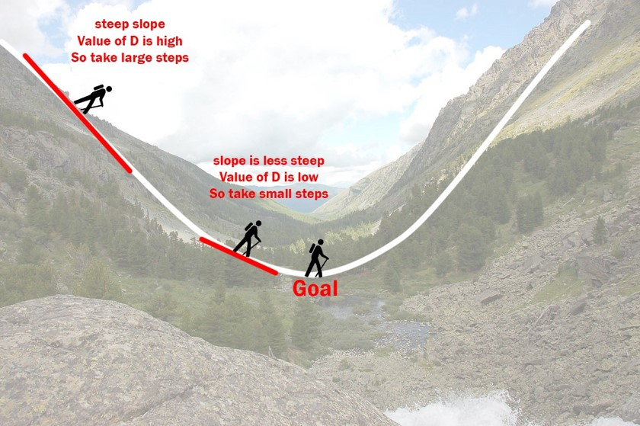
Optimizer
SGD (Stochastic Gradient Descent ) Optimizer.
Starting at the top of the mountain, we take our first step downhill in the direction specified by the negative gradient.
Recalculate the negative gradient (passing in the coordinates of our new point) and take another step in the direction it specifies
Repeat until local minimum

Slide 50
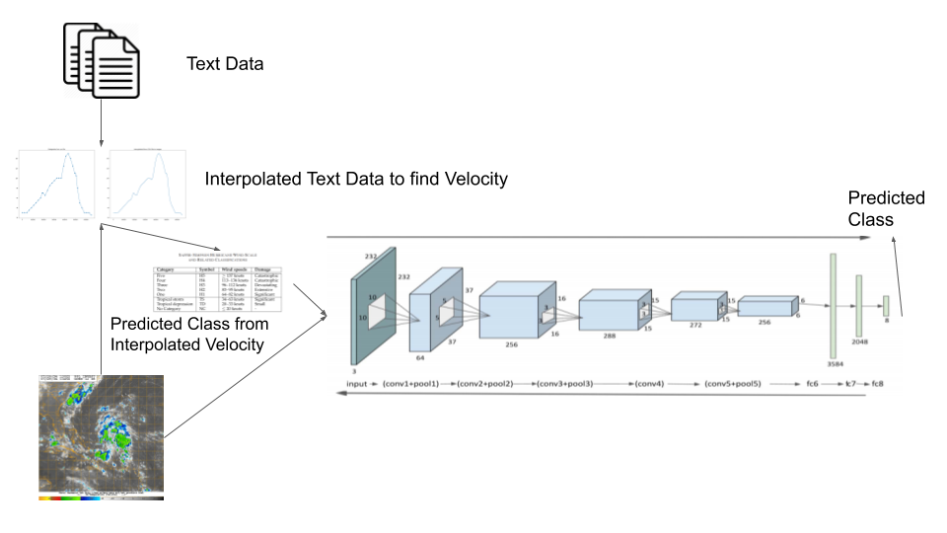
In Summary

Slide 51
Q&A Session

